Slide 1
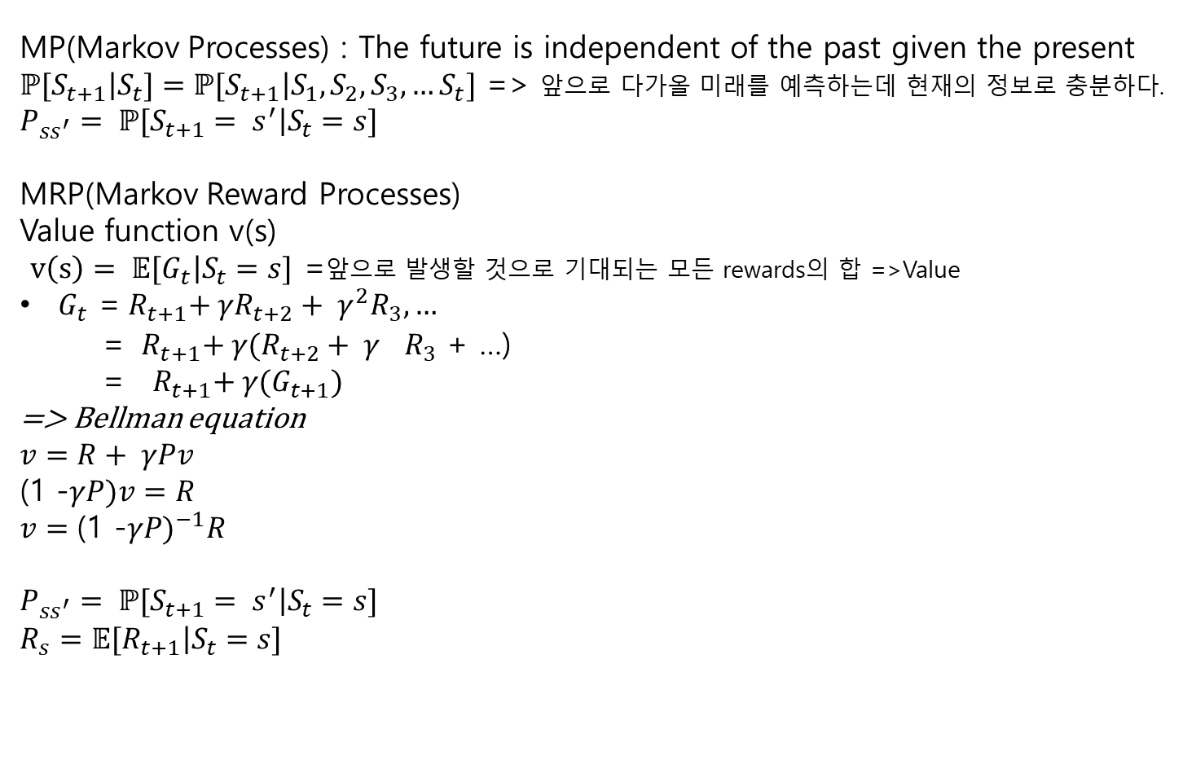
*들어가기 전
MP(Markov Processes) : The future is independent of the past given the present
$ℙ[\left.S_{t+1}\right|S_{t}]=ℙ[\left.S_{t+1}\right|{S_{1},S_{2},S_{3}, …S}_{t}]$ => 앞으로 다가올 미래를 예측하는데 현재의 정보로 충분하다.
$$P_{ss^{′}}= ℙ[\left.S_{t+1}= s^{′}\right|S_{t}=s]$$
MRP(Markov Reward Processes)
Value function v(s)
$v\left(s\right)= 𝔼[\left.G_{t}\right|S_{t}=s]$ =앞으로 발생할 것으로 기대되는 모든 rewards의 합 =>Value
$G_{t}$ =${{ R}_{t+1}+ γR_{t+2}+ γ^{2}R_{3}, …}_{}$
= ${ R}_{t+1}+ γ(R_{t+2}+ γ^{}R_{3}$ + …)
= ${ R}_{t+1}+ γ(G_{t+1})$
=> Bellman equation
$$v=R+ γPv$$
(1 -$γP)v=R$
$$v={\text{(1 −}γP)}^{−1}R$$
$$P_{ss^{′}}= ℙ[\left.S_{t+1}= s^{′}\right|S_{t}=s]$$
$$R_{s}=𝔼[\left.R_{t+1}\right|S_{t}=s]$$

Slide 2
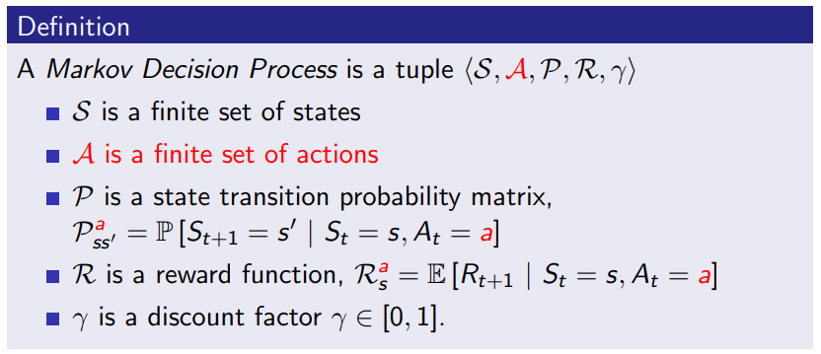



MDP ( Markov Decision Process)
Markov reward process with decisions
State $S_{t}$
Action $A_{t}$
Agent
Reward $R_{t+1}$
Environment

Slide 3
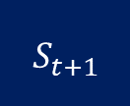
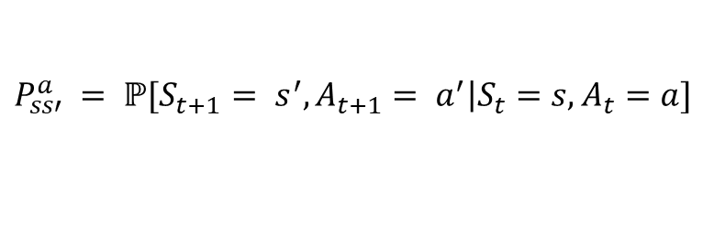

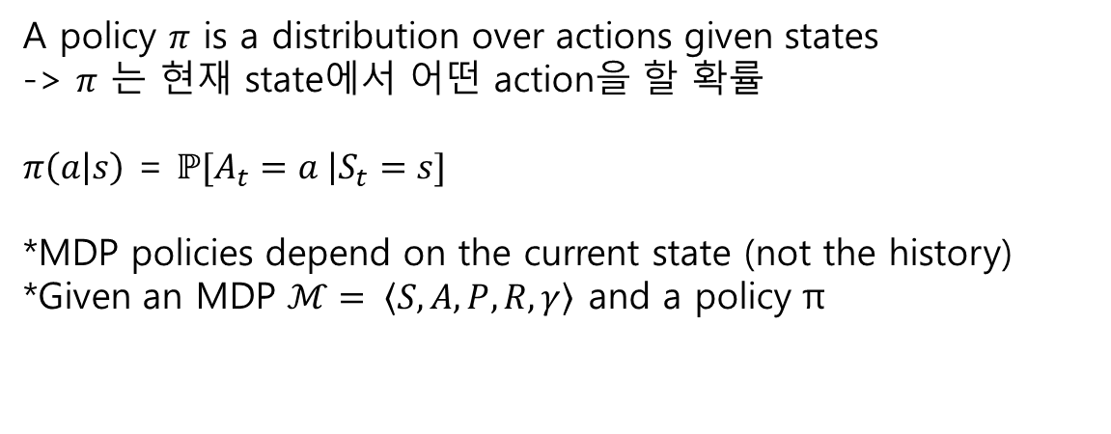
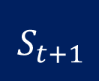

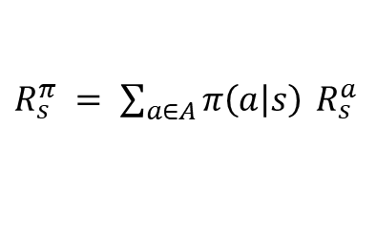
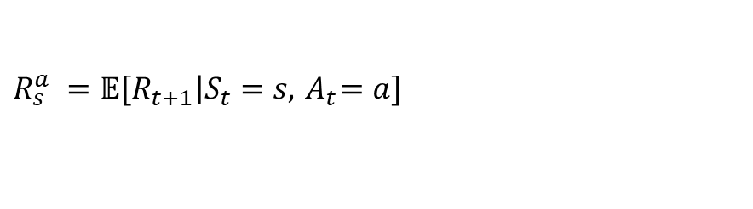
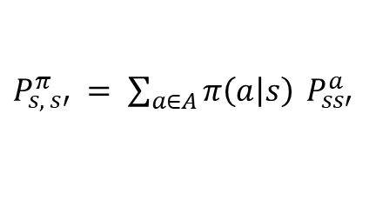
Policy
A policy $π$ is a distribution over actions given states
-> $π$ 는 현재 state에서 어떤 action을 할 확률
$π\left(a | s\right)$ = $ℙ[\left.A_{t}=a \right|S_{t}=s]$
*MDP policies depend on the current state (not the history)
*Given an MDP $ℳ= \left\langle S, A, P\right.\left.,R, γ\right\rangle$ and a policy π
Policy
: state s에서 action a를 할 확률
Transition probability
: state s에서 action a를 해서 state s’로 전이할 확률
$$P_{ss′}^{a} = ℙ[\left.S_{t+1}= s^{′},A_{t+1}= a^{′}\right|S_{t}=s,A_{t}=a]$$
$$R_{s}^{a} =𝔼[\left.R_{t+1}\right|S_{t}=s,{ A}_{t}=a]$$
$$S_{t}$$
$${ S}_{t+1}$$
$$S_{t}$$
action
$${ S}_{t+1}$$
MP & MRP
MDP
$P_{s, s′}^{π} = \sum_{a∈A}{π\left(a | s\right)}$ $P_{ss′}^{a}$
$R_{s}^{π} = \sum_{a∈A}{π\left(a | s\right)}$ $R_{s}^{a}$

Slide 4
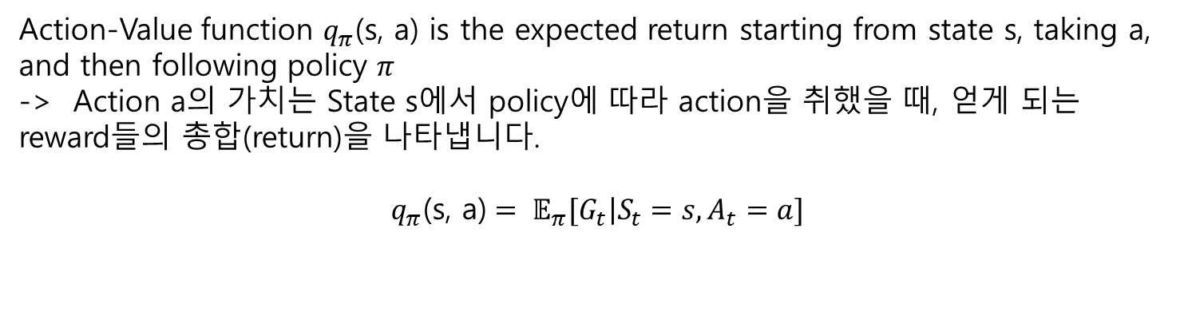
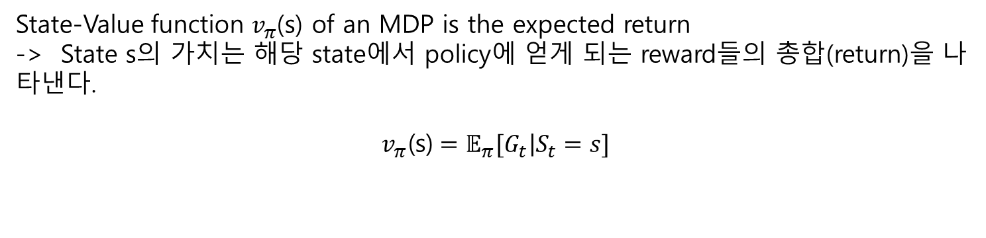
Value
Function
-Policy
State-Value function $v_{π}$(s) of an MDP is the expected return
-> State s의 가치는 해당 state에서 policy에 얻게 되는 reward들의 총합(return)을 나타낸다.
$$v_{π}\text{(}\text{s}\text{)}=𝔼_{π}[\left.G_{t}\right|S_{t}=s]$$
Action-Value function $q_{π}$(s, a) is the expected return starting from state s, taking a, and then following policy $π$
-> Action a의 가치는 State s에서 policy에 따라 action을 취했을 때, 얻게 되는 reward들의 총합(return)을 나타냅니다.
$$q_{π}\text{(}\text{s}\text{, }\text{a}\text{)}= 𝔼_{π}[\left.G_{t}\right|S_{t}=s,A_{t}=a]$$

Slide 5
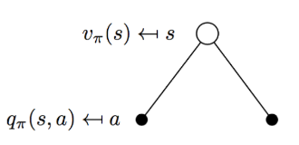
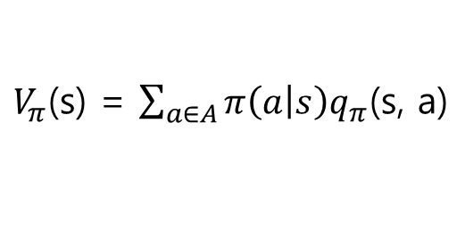

Bellman
Expectation
Equation
State-Value
State-Value function $v_{π}$(s)
$$v_{π}\text{(}\text{s}\text{)}=𝔼_{π}[\left.G_{t}\right|S_{t}=s]$$
=$v_{π}\text{(}\text{s}\text{)}=𝔼_{π}[\left.R_{t+1}+ γv_{π}(S_{t+1})\right|S_{t}=s]$
$V_{π}$(s) = $\sum_{a∈A}{π\left(a | s\right)q_{π}\text{(}\text{s}\text{, }\text{a}\text{)}}$

Slide 6
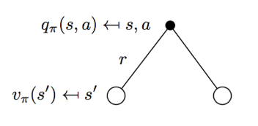
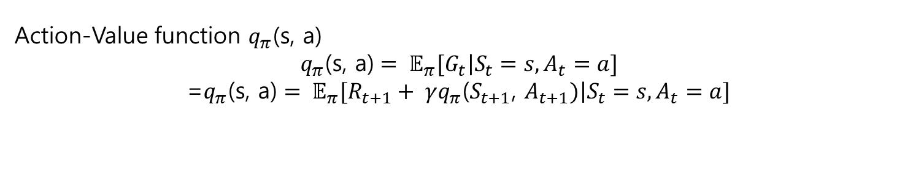
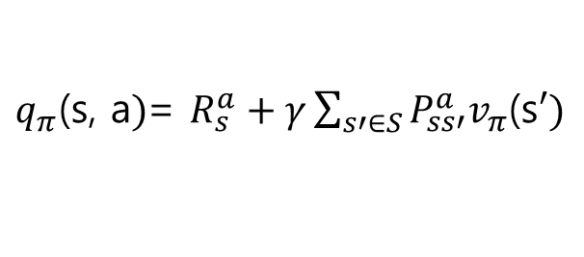
Bellman
Expectation
Equation
Action-Value
Action-Value function $q_{π}$(s, a)
$$q_{π}\text{(}\text{s}\text{, }\text{a}\text{)}= 𝔼_{π}[\left.G_{t}\right|S_{t}=s,A_{t}=a]$$
=$q_{π}\text{(}\text{s}\text{, }\text{a}\text{)}= 𝔼_{π}[\left.R_{t+1}+ γq_{π}\text{(}S_{t+1}\text{,} A_{t+1})\right|S_{t}=s,A_{t}=a]$
$q_{π}\text{(}\text{s}\text{, }\text{a})$= $R_{s}^{a}+γ\sum_{s′∈S}{P_{ss′}^{a}v_{π}\text{(}\text{s}′)}$

Slide 7
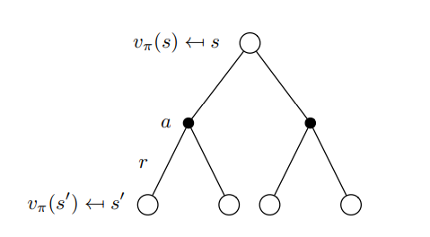
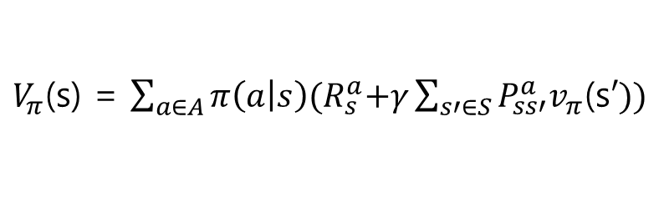
Bellman
Expectation
Equation
State-Value
(2)
State-Value function $v_{π}$(s)
$$v_{π}\text{(}\text{s}\text{)}=𝔼_{π}[\left.G_{t}\right|S_{t}=s]$$
=$v_{π}\text{(}\text{s}\text{)}=𝔼_{π}[\left.R_{t+1}+ γv_{π}(S_{t+1})\right|S_{t}=s]$
$V_{π}$(s) = $\sum_{a∈A}{π\left(a | s\right){(R}_{s}^{a}+γ\sum_{s′∈S}{P_{ss′}^{a}v_{π}\text{(}\text{s}′))}}$

Slide 8
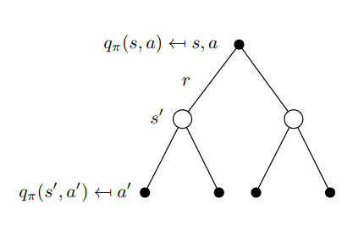
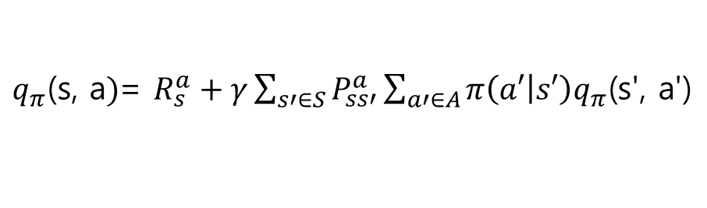
Bellman
Expectation
Equation
Action-Value
(2)
Action-Value function $q_{π}$(s, a)
$$q_{π}\text{(}\text{s}\text{, }\text{a}\text{)}= 𝔼_{π}[\left.G_{t}\right|S_{t}=s,A_{t}=a]$$
=$q_{π}\text{(}\text{s}\text{, }\text{a}\text{)}= 𝔼_{π}[\left.R_{t+1}+ γq_{π}\text{(}S_{t+1}\text{,} A_{t+1})\right|S_{t}=s,A_{t}=a]$
$q_{π}\text{(}\text{s}\text{, }\text{a})$= $R_{s}^{a}+γ\sum_{s′∈S}{P_{ss′}^{a}\sum_{a′∈A}{π\left(a′ | s′\right)q_{π}\text{(}\text{s}\text{'}\text{, }\text{a}\text{'}\text{)}}}$

Slide 9
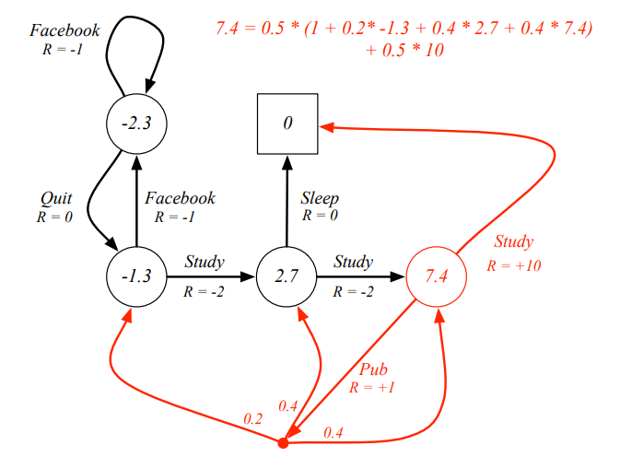



Example
$v\left(s\right)$ for $π\left(a | s\right)=0.5, γ=1$
$v_{π}$ = $R^{π}+ γP^{π}v_{π}$
$v_{π}$ = ${\left(I − γP^{π}\right)}^{−1}R^{π}$
The Bellman expectation equation can be expressed concisely using the induced MRP

